Slide 1


Single cell RNA Seq Snap workflow (ScRNASeqSnap)
Antonia (Tonia) Chroni, PhD
Senior Bioinformatics Research Scientist
DNB Bioinformatics Core
December 10, 2024

Slide 2





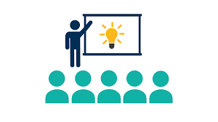

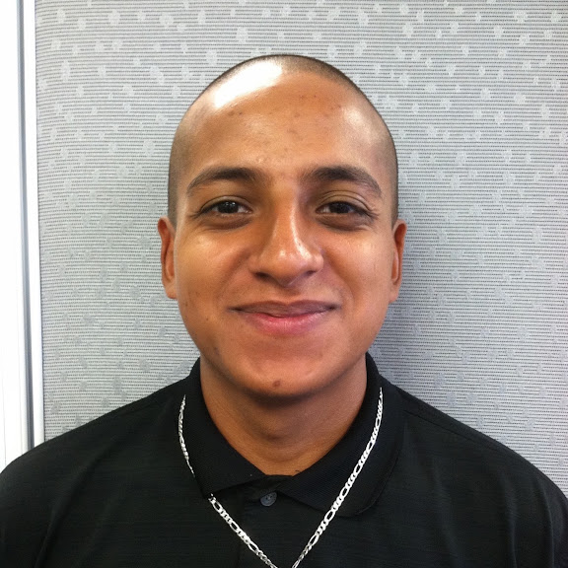
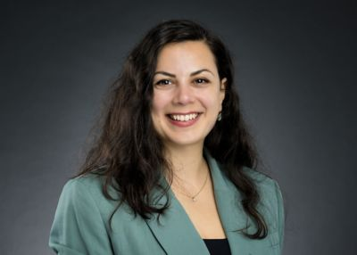
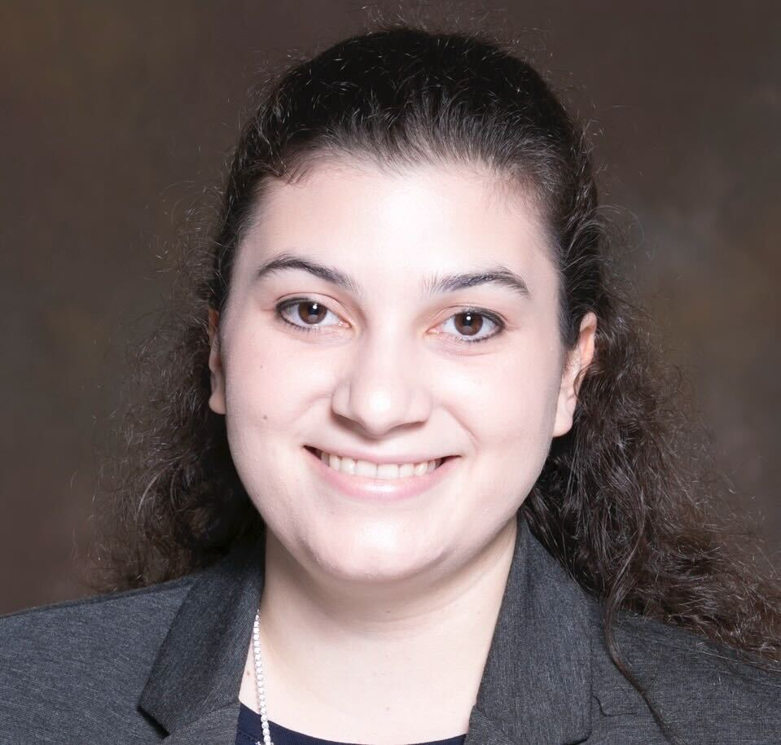

Bioinformatics core, Department of Developmental Neurobiology
Providing advanced bioinformatic services for investigators to leverage omics data
Project analysis & Benchmarking
Consultation
Training
Innovation
Cody Alexander Ramirez, PhD
Senior Bioinformatics Research Scientist
Core Director
Boston, Massachusetts
Antonia Chroni, PhD
Senior Bioinformatics Research Scientist
New York, New York
Sharon Freshour, PhD
Bioinformatics Research Scientist
St. Louis, Missouri
Asha Jacob Jannu, PhD
Bioinformatics Research Scientist
Indianapolis, Indiana
Notes:
All the material can be found at our GitHub under the ‘Trainings’ repository.

Slide 3
Code of Conduct
No child is denied treatment based on race, religion, or a family's ability to pay.
Advance cures and prevention for pediatric catastrophic diseases through research and treatment.
Be respectful and graceful
Gracefully accept constructive criticism.
Focus on what is best for the community.
Welcoming and inclusive
Value and respect everyone’s viewpoints and experiences.
Use welcoming and inclusive language.
Share groundbreaking discoveries and research.
Show courtesy and respect towards other community members.
Be kind
and
have fun
We welcome everyone in the research community.
We are committed to creating a friendly and respectful place for learning, teaching, and contributing.
Notes:
Our mission is to improve the survival rates of children with cancer and other catastrophic diseases, worldwide,
through the sharing of knowledge, technology and organizational skills. Our vision is that every child diagnosed with cancer or another catastrophic disease has access to quality care and treatment.
Appropriate behavior includes but is not limited to:

Slide 4
Learning Objectives
Overview of Tools and Methods in the `ScRNASeqSnap` pipeline
Reviewing Results, Plots, and Reports

Slide 5
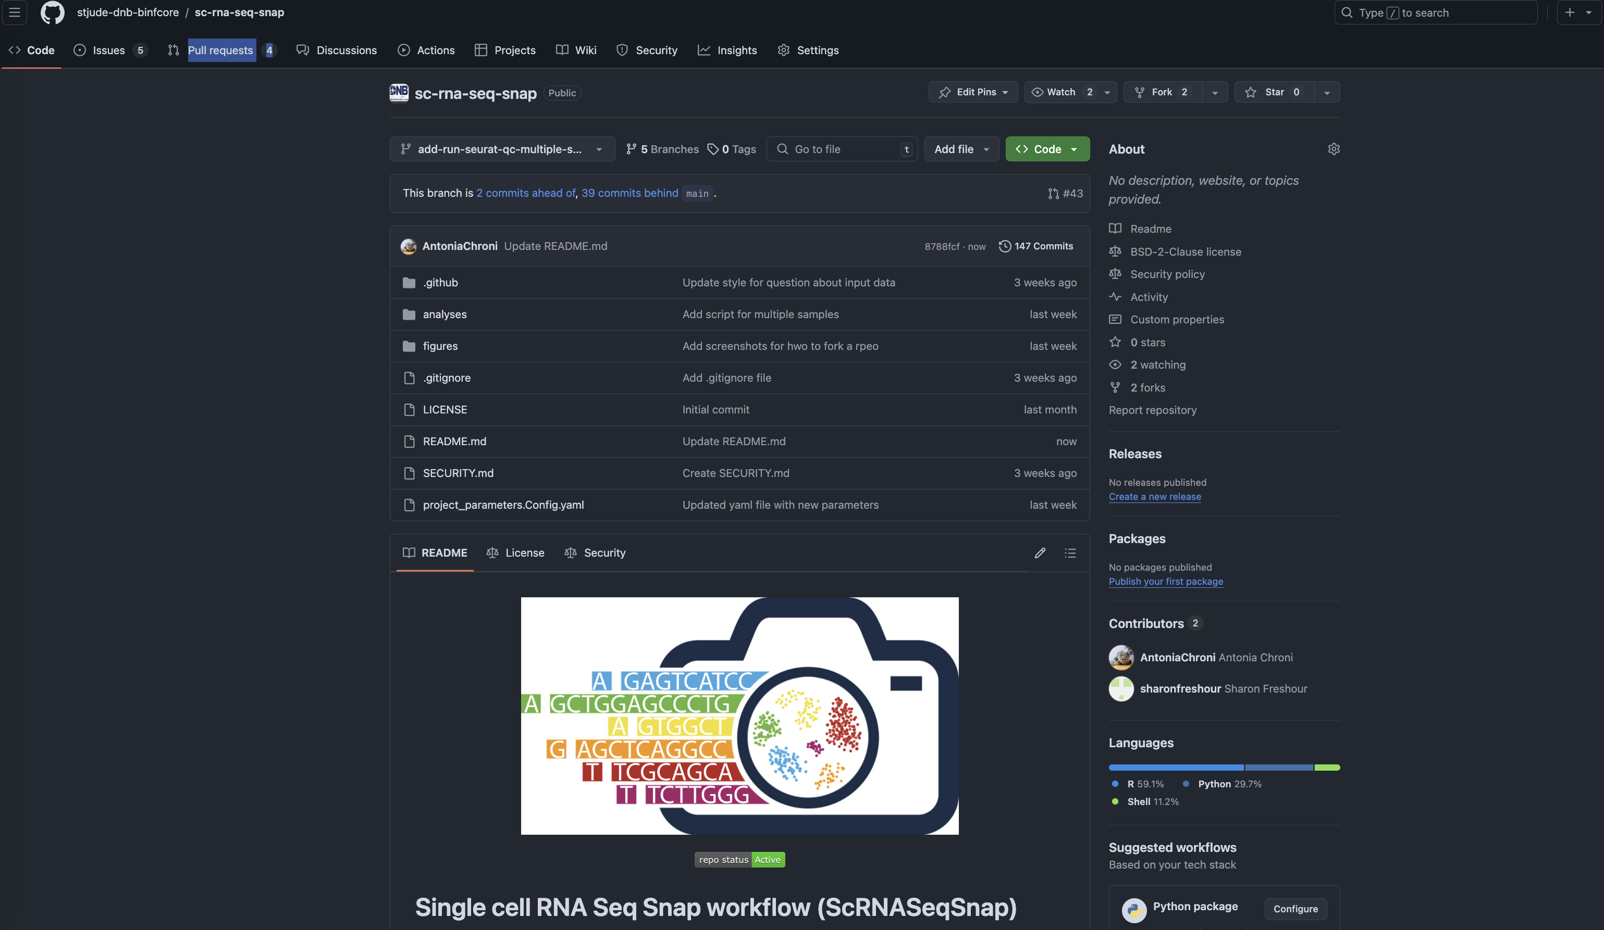
Single cell RNA Seq Snap workflow (ScRNASeqSnap)
Notes:
In software development, and specifically, in the context of cancer informatics, we deal with very complex projects that often utilize multiple omics data which in turn need sophisticated algorithms and pipelines for data analysis and interpretation.
Good documentation helps users understand how to use software tools, datasets, and workflows. It facilitates reproducibility and enables collaboration among researchers.
Automating repetitive tasks can save time and reduce human error.
Containers allow for versioning and accessibility, and keep updated software versions.

Slide 6
Single cell RNA Seq Snap workflow (ScRNASeqSnap)
Slide 1: show organization
Summary report
Slide 3: figures, where to find raw files
Maintain a structured and predictable organization system
Notes:
In software development, and specifically, in the context of cancer informatics, we deal with very complex projects that often utilize multiple omics data which in turn need sophisticated algorithms and pipelines for data analysis and interpretation.
Good documentation helps users understand how to use software tools, datasets, and workflows. It facilitates reproducibility and enables collaboration among researchers.
Automating repetitive tasks can save time and reduce human error.
Containers allow for versioning and accessibility, and keep updated software versions.

Slide 7



Best practices for reproducibility
Documentation & Usability
Automation
Containers
Notes:
In software development, and specifically, in the context of cancer informatics, we deal with very complex projects that often utilize multiple omics data which in turn need sophisticated algorithms and pipelines for data analysis and interpretation.
Good documentation helps users understand how to use software tools, datasets, and workflows. It facilitates reproducibility and enables collaboration among researchers.
Automating repetitive tasks can save time and reduce human error.
Containers allow for versioning and accessibility, and keep updated software versions.

Slide 8
Project organization and tidiness
Use Folders/Directories
Keep separate projects separated
Separate sections for units within a project
analyses/<module_name>
code
plots
results
reports
data
figures
project_parameters.Config.yaml
…
Documentation throughout: Describe what files do and how they are organized/folder.
Notes:
In software development, and specifically, in the context of cancer informatics, we deal with very complex projects that often utilize multiple omics data which in turn need sophisticated algorithms and pipelines for data analysis and interpretation.
Good documentation helps users understand how to use software tools, datasets, and workflows. It facilitates reproducibility and enables collaboration among researchers.
Automating repetitive tasks can save time and reduce human error.
Containers allow for versioning and accessibility, and keep updated software versions.

Slide 9
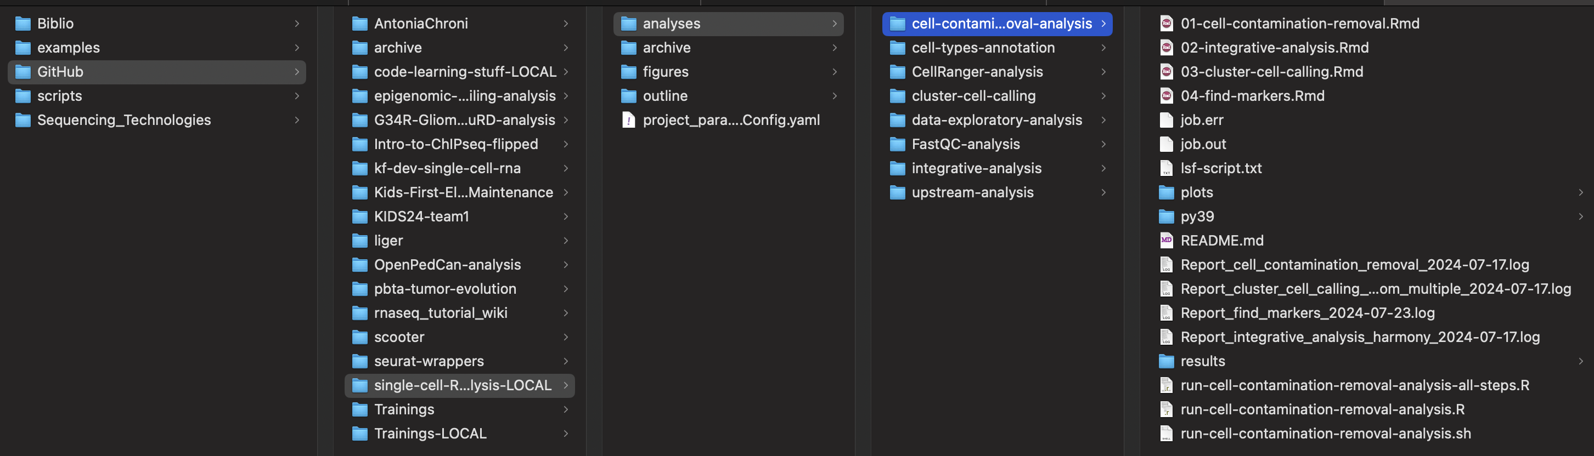
My typical project organization system
Notes:
Explain my thought process – organization,

Slide 10
My typical project organization system
Notes:
Explain my thought process – organization,

Slide 11
Organization
Notes:
In software development, and specifically, in the context of cancer informatics, we deal with very complex projects that often utilize multiple omics data which in turn need sophisticated algorithms and pipelines for data analysis and interpretation.
Good documentation helps users understand how to use software tools, datasets, and workflows. It facilitates reproducibility and enables collaboration among researchers.
Automating repetitive tasks can save time and reduce human error.
Containers allow for versioning and accessibility, and keep updated software versions.

Slide 12
Organization
Notes:
In software development, and specifically, in the context of cancer informatics, we deal with very complex projects that often utilize multiple omics data which in turn need sophisticated algorithms and pipelines for data analysis and interpretation.
Good documentation helps users understand how to use software tools, datasets, and workflows. It facilitates reproducibility and enables collaboration among researchers.
Automating repetitive tasks can save time and reduce human error.
Containers allow for versioning and accessibility, and keep updated software versions.

Slide 13
Best practices for reproducibility 🎉
Make an outline
What is the snap pipeline
Where it is available, how to download, how to uset he container
Code review process: test-dataset – validation phase will follow with human and pdx experiment
What do I want o show them during the workshop? Modules, scope of module, method(s), results, plots, reports: how do these looks like
Notes:
In software development, and specifically, in the context of cancer informatics, we deal with very complex projects that often utilize multiple omics data which in turn need sophisticated algorithms and pipelines for data analysis and interpretation.
Good documentation helps users understand how to use software tools, datasets, and workflows. It facilitates reproducibility and enables collaboration among researchers.
Automating repetitive tasks can save time and reduce human error.
Containers allow for versioning and accessibility, and keep updated software versions.

Slide 14
Reviewing Results, Plots, and Reports
Notes:
In software development, and specifically, in the context of cancer informatics, we deal with very complex projects that often utilize multiple omics data which in turn need sophisticated algorithms and pipelines for data analysis and interpretation.
Good documentation helps users understand how to use software tools, datasets, and workflows. It facilitates reproducibility and enables collaboration among researchers.
Automating repetitive tasks can save time and reduce human error.
Containers allow for versioning and accessibility, and keep updated software versions.

Slide 15
….
1. Overview of Tools and Methods in the Repo
Introduction to Key Tools: Start by briefly explaining the tools available in the repository for testing and code review. This could include things like linters, testing frameworks (e.g., pytest, JUnit), static analysis tools, and coverage analyzers.
How the Tools Integrate: Discuss how these tools are integrated into the codebase. For example, whether they are part of the CI/CD pipeline, triggered manually, or run locally by developers before submitting changes.
2. Testing Methods
Types of Tests: Break down the types of tests being run (unit tests, integration tests, functional tests, etc.).
Automated vs Manual Testing: Highlight the difference between automated tests (e.g., unit tests) and manual testing methods that may be required during the code review process.
Code Coverage: Walk through how coverage reports are generated and interpreted to ensure that the codebase is thoroughly tested.
3. Reviewing Results and Reports
Test Results: Show how to interpret the output from test runs. This may include interpreting pass/fail statuses, error messages, and performance metrics.
Code Quality Reports: If you’re using static analysis tools, discuss how the reports are generated, what they highlight (e.g., potential bugs, security vulnerabilities, code smells), and how they help during code reviews.
Visualizations and Plots: If the repo generates any graphical outputs (e.g., test coverage plots, performance graphs), demonstrate how to read and interpret these visualizations. Discuss the importance of such plots in ensuring the code’s health.
4. Best Practices for Code Reviews
Automated Review Tools: Highlight any tools in the repo that automate part of the code review process, such as linters or security scanners, and how they can assist in early detection of issues.
Manual Review Techniques: Emphasize the importance of reviewing the code manually even after automated tests pass. Provide guidance on what to look for (e.g., clarity, maintainability, and adherence to coding standards).
Collaboration: Discuss how the results from tools and testing can inform collaborative discussions during the review phase. Encourage reviewers to focus on constructive feedback that improves both the functionality and quality of the code.
5. Addressing Common Pitfalls
Misinterpreting Test Results: Explain common mistakes that developers might make when interpreting test results and how to avoid them.
Overlooking Test Coverage Gaps: Address the risks of relying too heavily on test coverage percentage without considering the quality of the tests themselves.
6. Q&A and Hands-On Demos
Live Walkthrough: If possible, walk the attendees through some real examples of results from the testing phase, showing how the tools have flagged issues, and discuss how to address them.
Interactive Discussion: Allow time for participants to ask questions or share their experiences with the tools and methods used in the repo.
Notes:
My personal journey with reproducibility and appreciating its great power has been started and challenged

Slide 16
More resources 🎉
…..

Slide 17


Slide 18
Ask me questions 😀
..
Tonia
Antonia Chroni, PhD
she/her/hers
Senior Bioinformatics Research Scientist
New York, New York
@AntoniaChroni

